Slide 1


District Five
Projects Update
November, 2014
Florida Department of TRANSPORTATION

Slide 2
November, 2014
UNDER CONSTRUCTION
  #1 I-4 from SR 44 to I-95
  #2 I-95 from Brevard County to SR 44
  #3 I-95 Interchange @ I-4/US 92 and widening to SR 44
  #4 US 92 Pedestrian Safety Improvements
UPCOMING
I-95 Interchange @ Matanzas Woods Pkwy
I-4 Managed Lanes PD&E Study

Slide 3
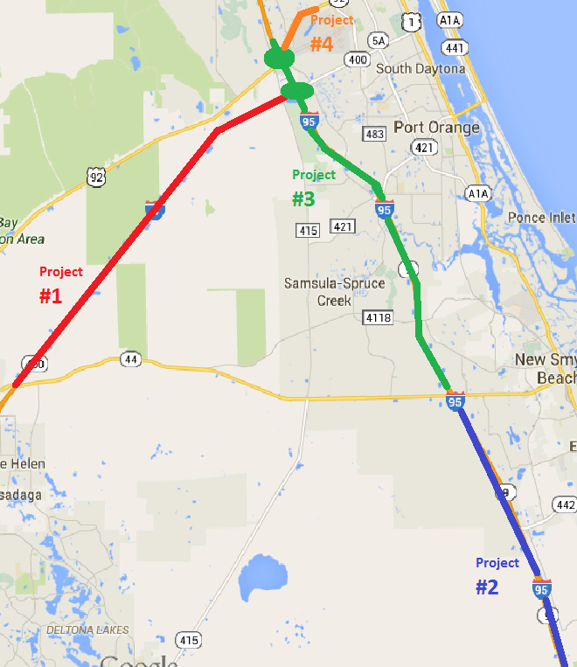
UNDER CONSTRUCTION
  #1 I-4
  from SR 44 to I-95
  #2 I-95
  from Brevard County to SR 44
  #3 I-95 Interchange @ I-4/US 92 and widening to SR 44
  #4 US 92 Pedestrian
  Safety Improvements

Slide 4
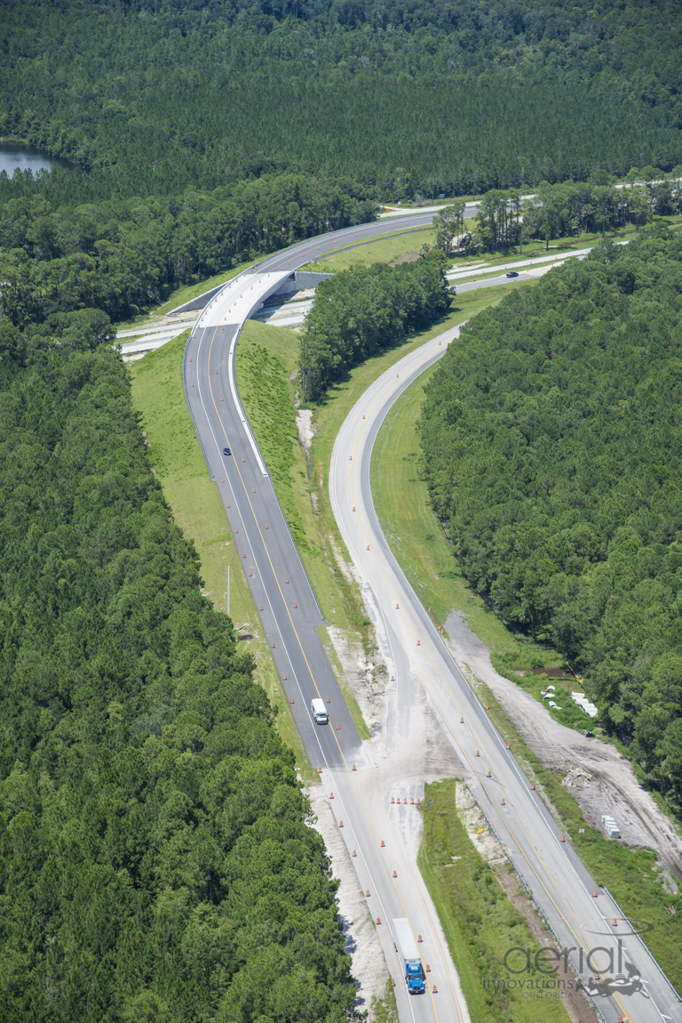
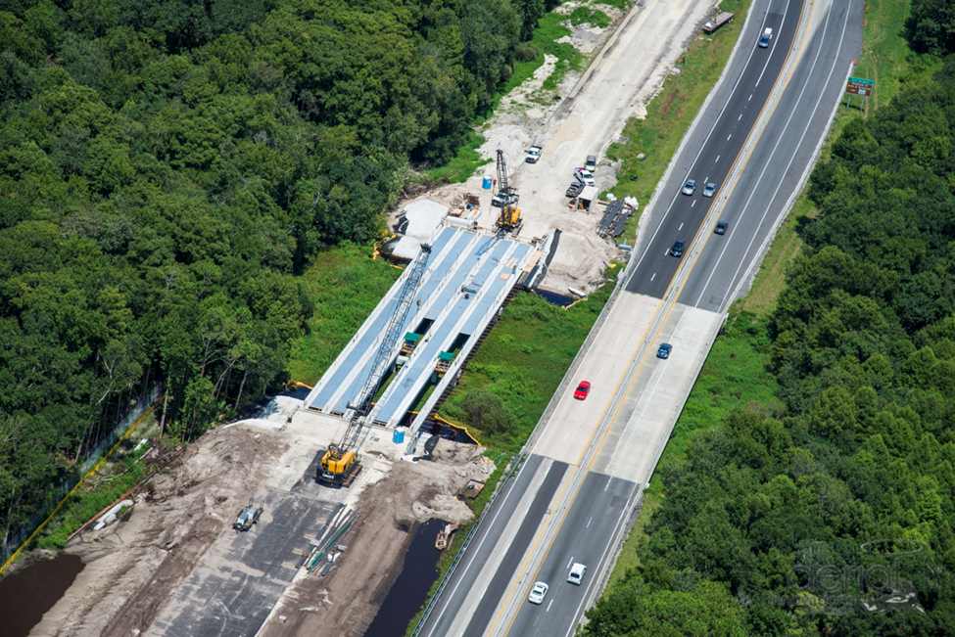
Project #1
I-4 WIDENING
From SR 44 TO I-95
Flyover from US 92 to I-4
I-4 at the Tomoka River

Slide 5
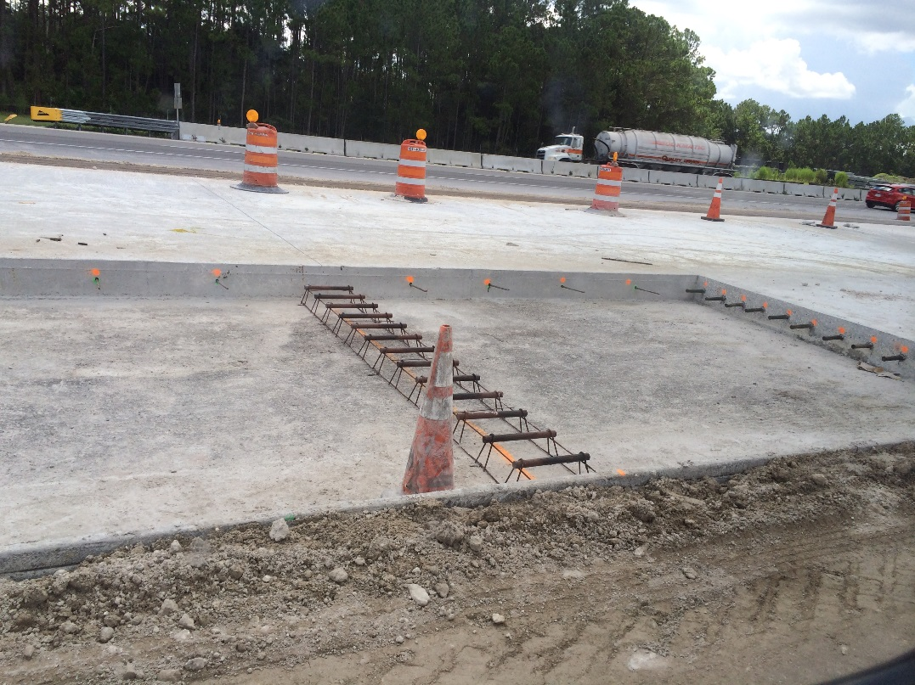
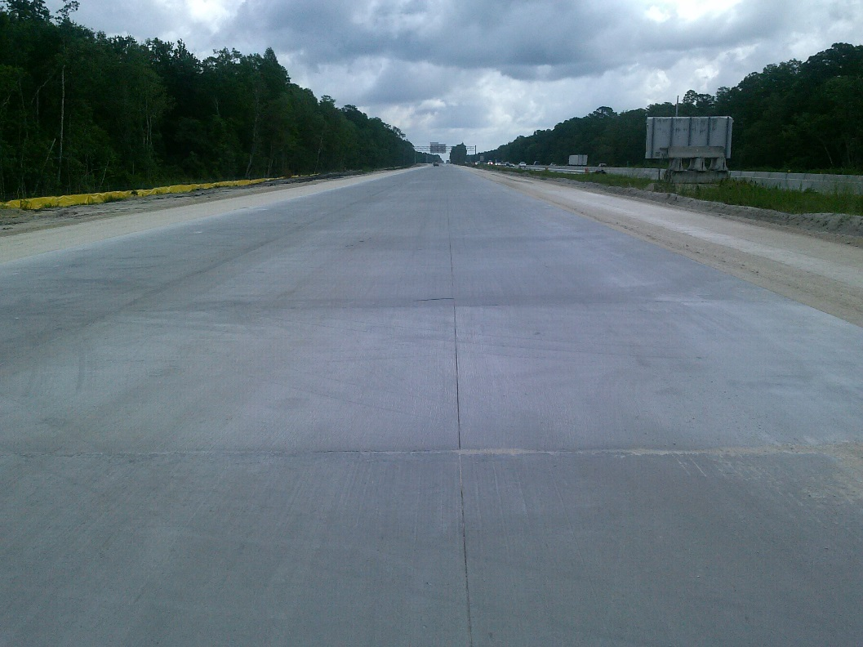
Project #1
I-4 WIDENING
From SR 44 TO I-95
On-going Construction Activities:
  Temporary pavement and shoulders for the next traffic phase
  Concrete paving
  Ramp and bridge from I-4 to US 92

Slide 6
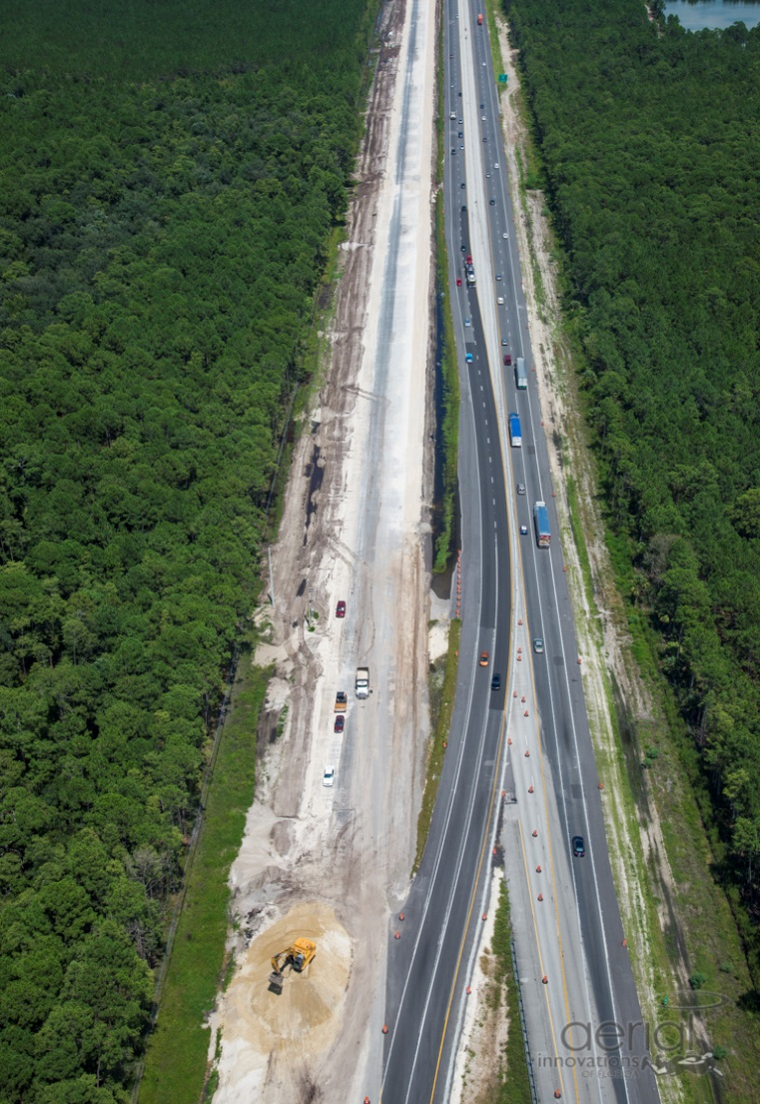
Project #1
I-4 WIDENING
From SR 44 TO I-95
  Estimated project completion:
  May 2016
I-4 Corridor

Slide 7
UNDER CONSTRUCTION
  #1 I-4
  from SR 44 to I-95
  #2 I-95
  from Brevard County to SR 44
  #3 I-95 Interchange @ I-4/US92 and widening to SR 44
  #4 US 92 Pedestrian
  Safety Improvements

Slide 8
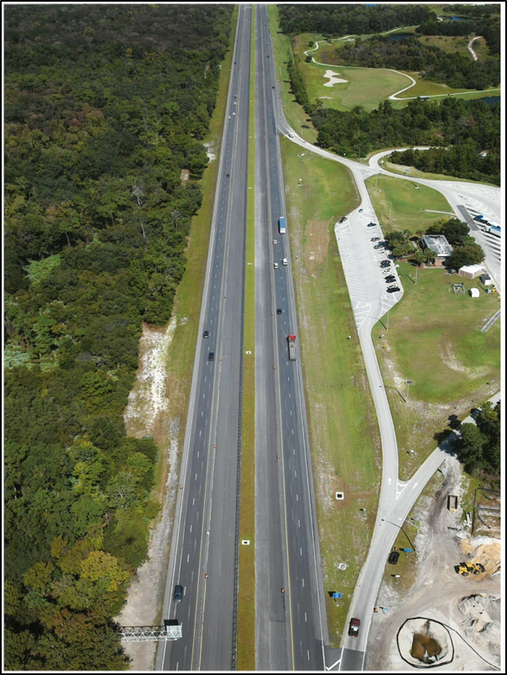
Project #2
I-95 WIDENING
From Brevard County to SR 44
I-95 Corridor
  Widening to Brevard/Volusia line complete
  early 2016.
  Widening from Brevard/Volusia line to SR 44 complete
  Spring 2016.

Slide 9
UNDER CONSTRUCTION
  #1 I-4
  from SR 44 to I-95
  #2 I-95
  from Brevard County to SR 44
  #3 I-95 Interchange @ I-4/US92 and widening to SR 44
  #4 US 92 Pedestrian
  Safety Improvements

Slide 10
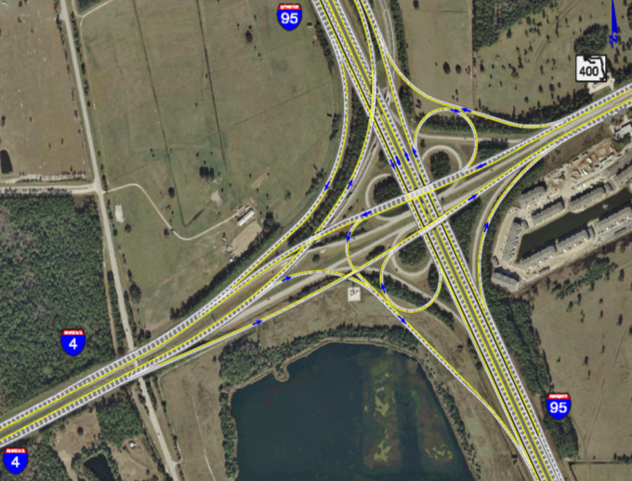
Project #3
I-95 INTERCHANGE @ I-4 / US 92 and widening to SR 44
I-95 & I-4 INTERCHANGE
I-95 & US 92 INTERCHANGE

Slide 11
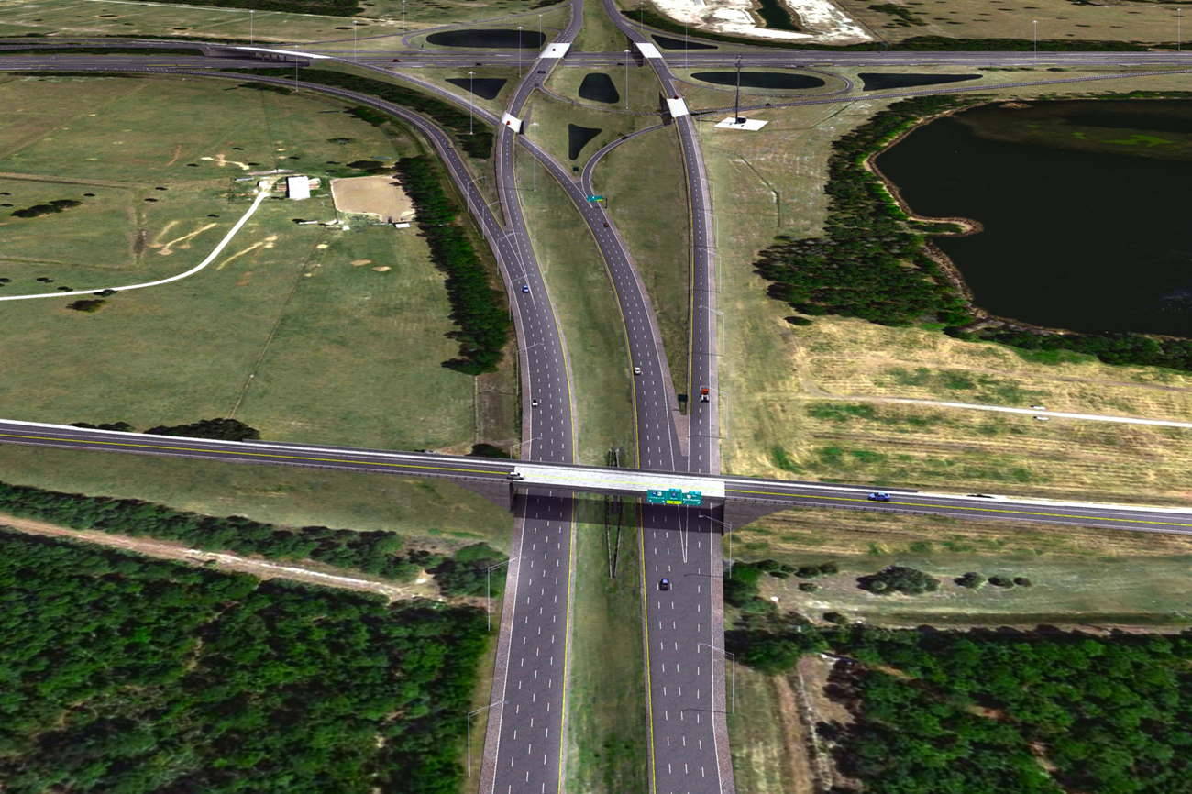
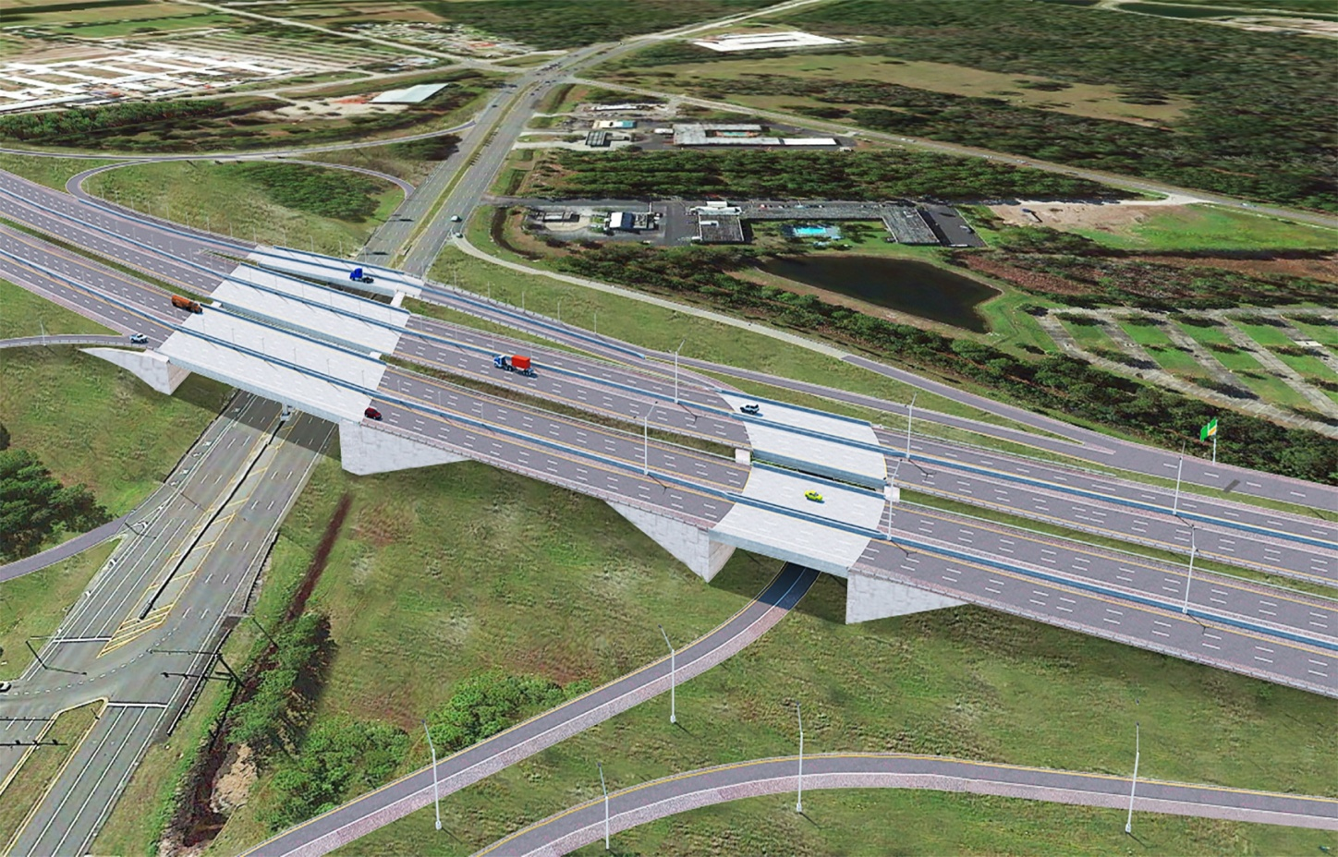
Project #3
I-95 Interchange @ I-4/US 92
and widening to SR 44
  Construction begins January 2015
  MOT phasing for events in Daytona
  Project complete late 2017
I-95 & US 92 INTERCHANGE
I-95 & I-4 INTERCHANGE

Slide 12
UNDER CONSTRUCTION
  #1 I-4
  from SR 44 to I-95
  #2 I-95
  from Brevard County to SR 44
  #3 I-95 Interchange @ I-4/US92 and widening to SR 44
  #4 US 92 Pedestrian
  Safety Improvements

Slide 13
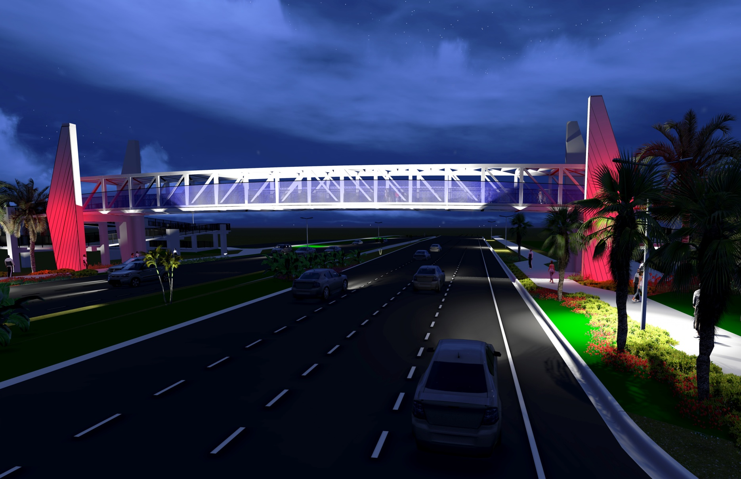
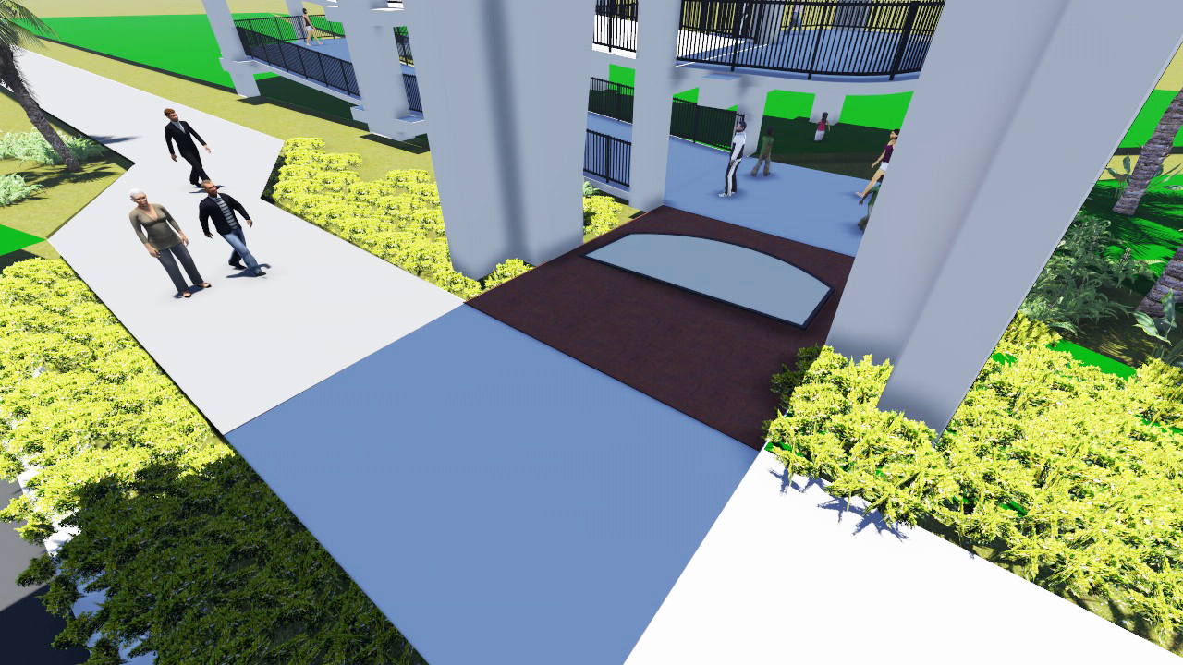
Project #4
US 92 (ISB) PEDESTRIAN SAFETY IMPROVEMENTS from Williamson Blvd to Midway Ave
November 26, 2014

Slide 14
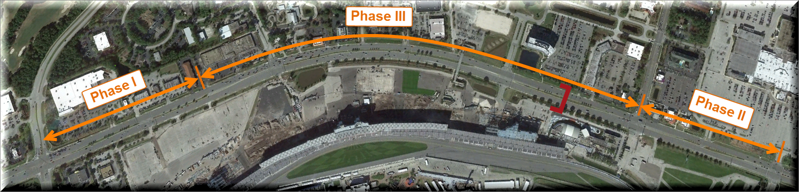
Project #4
US 92 Pedestrian Safety
Phasing Activities:
  Demucking
  Stormwater pipe installation
  Sidewalk
Scheduled Completion
Late 2015

Slide 15
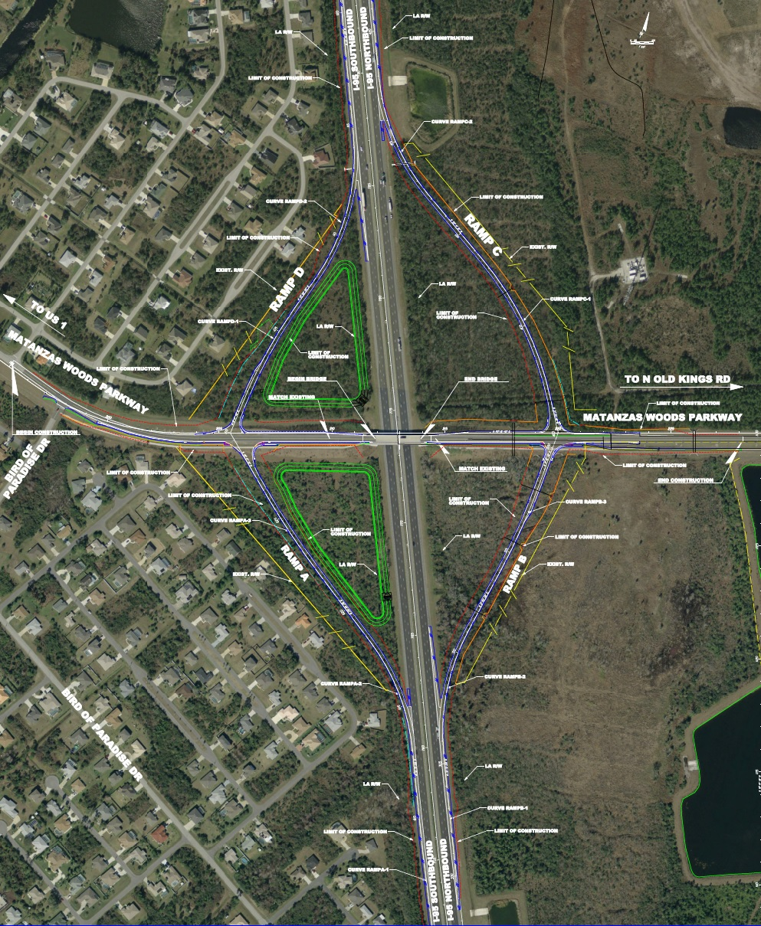
I-95 Interchange @ Mantanzas Woods Parkway
I-4 Corridor
Work overseen by Flagler County
Construction starts
early spring of 2015
Expected completion
summer 2016
Mantanzas Woods
Interchange@ I-95

Slide 16
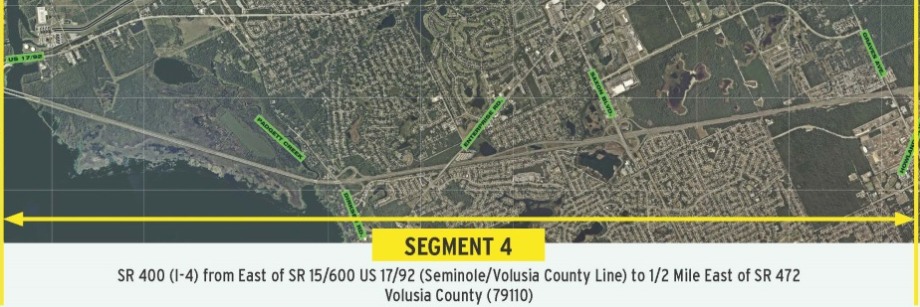
I-4 Managed Lanes from Seminole County to SR 472

Slide 17
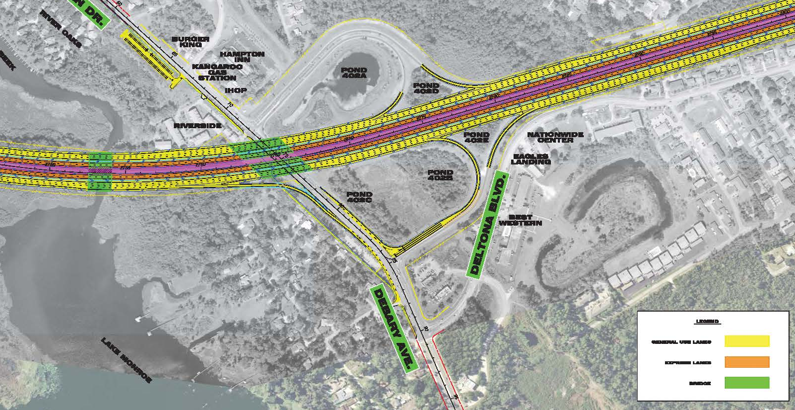
I-4 Managed Lanes
Dirksen Drive/Debary Avenue
Add ramp from I-4 to eastbound Debary Avenue
Preserve recently constructed trail
Relocate park and ride to the west side of I-4
Relocated Park and Ride
New Ramp

Slide 18
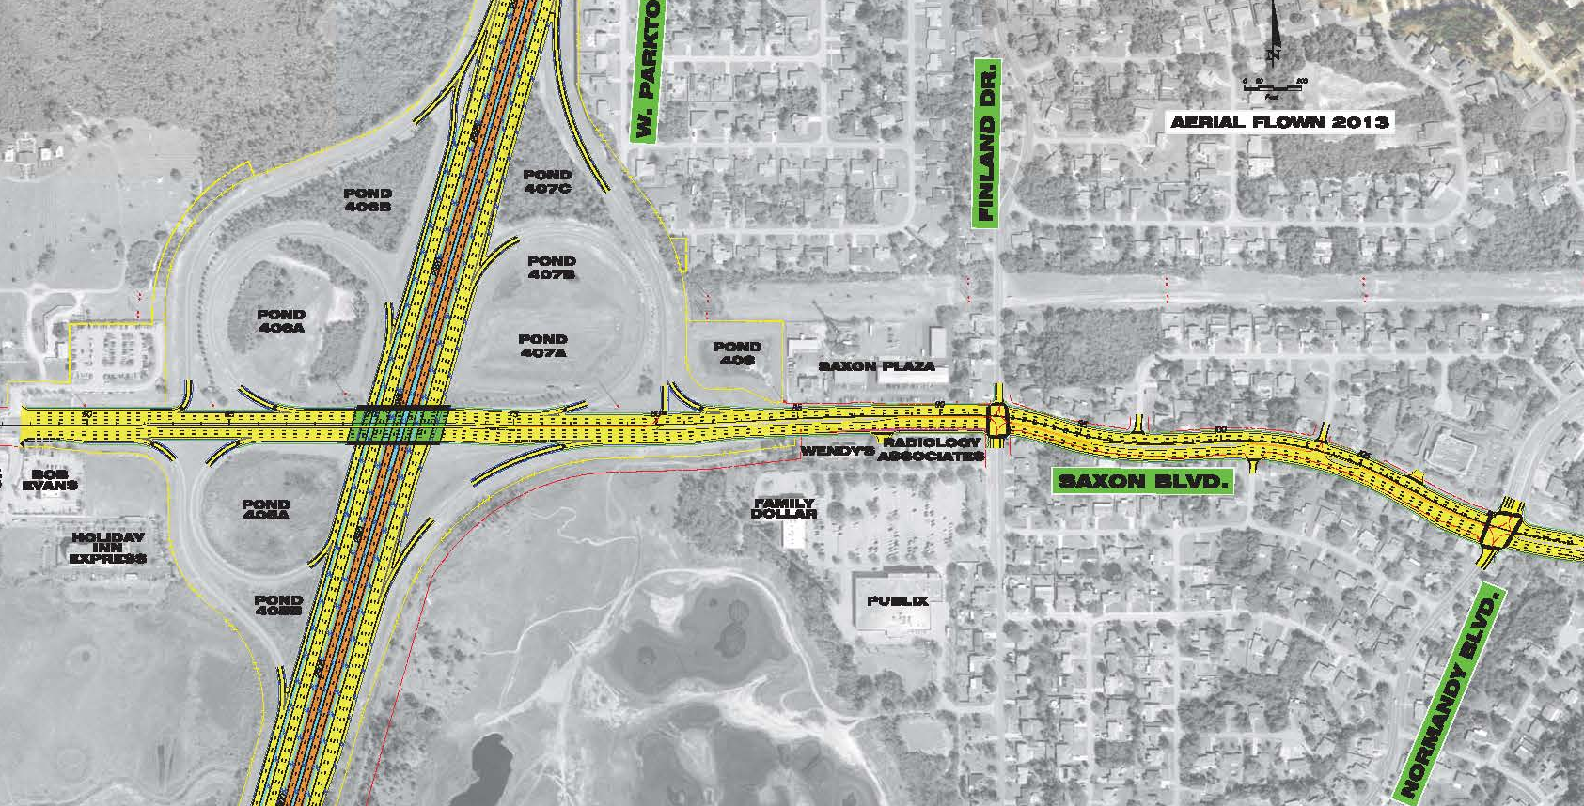
I-4 Managed Lanes
Saxon Boulevard
Widening of Saxon Blvd to Normandy Blvd
Six Lanes
Ramp Improvements

Slide 19
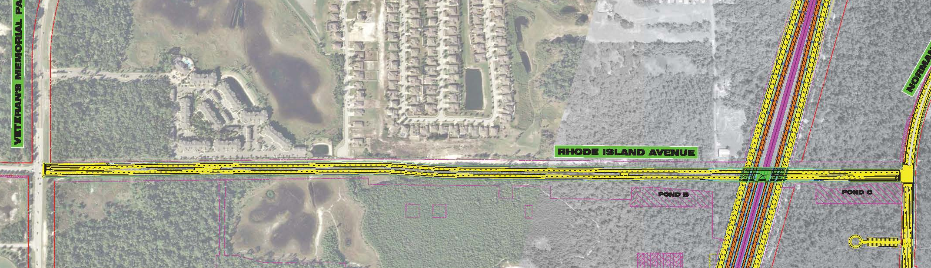
I-4 Managed Lanes
Rhode Island Avenue Extension
Direct connect to Express lanes
Construct all 4 lanes
Park & Ride on east side
Four Lanes
New Express Lane Interchange
New Park and Ride

Slide 20
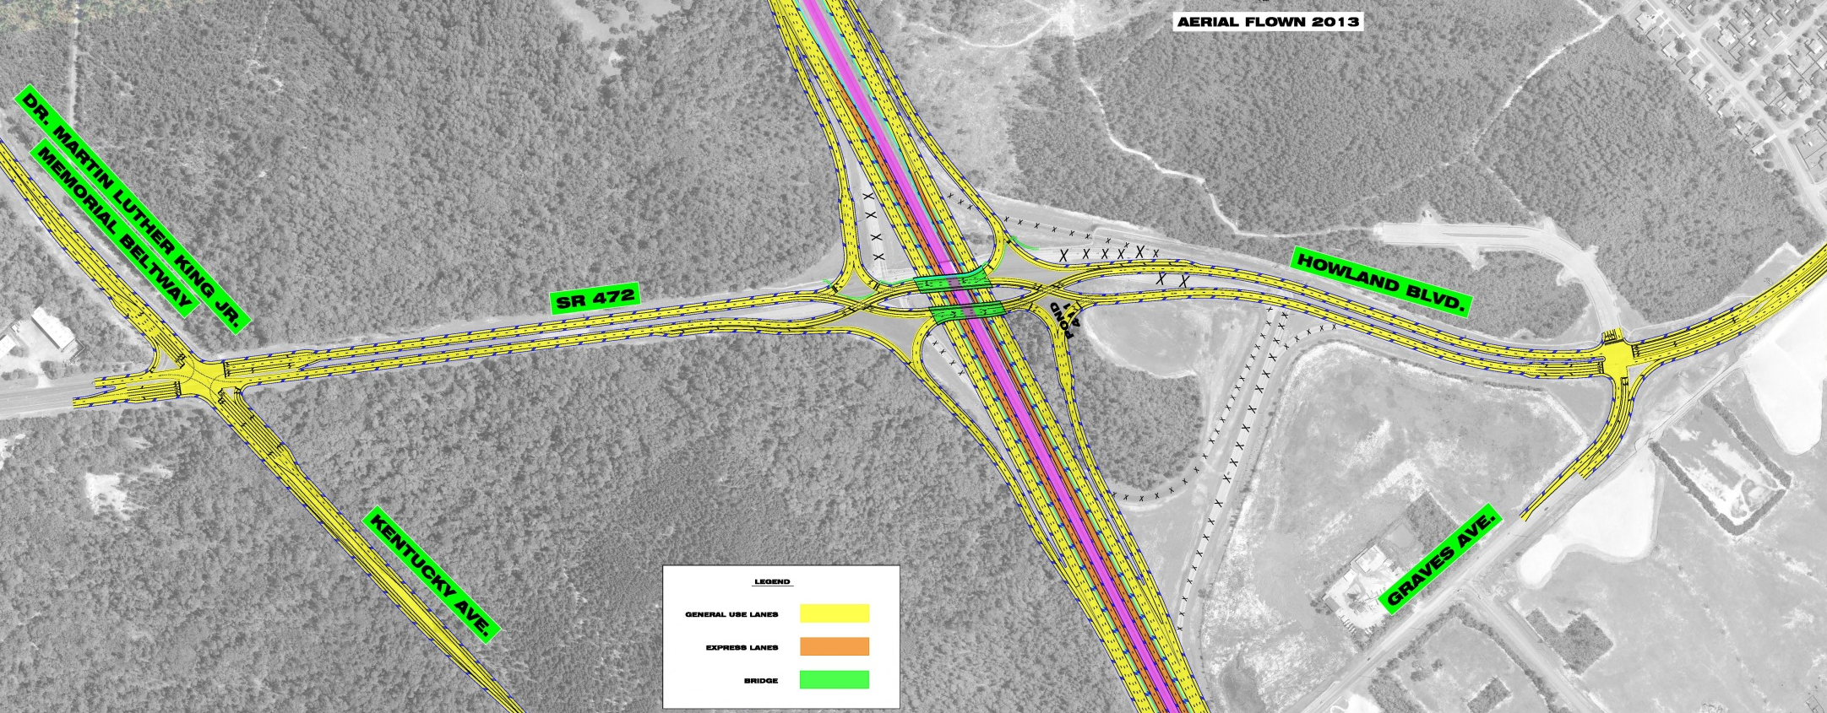
I-4 Managed Lanes
SR 472
Diverging Diamond Interchange
Improvements at MLK and Graves
Intersection Improvements
Intersection Improvements

Slide 21
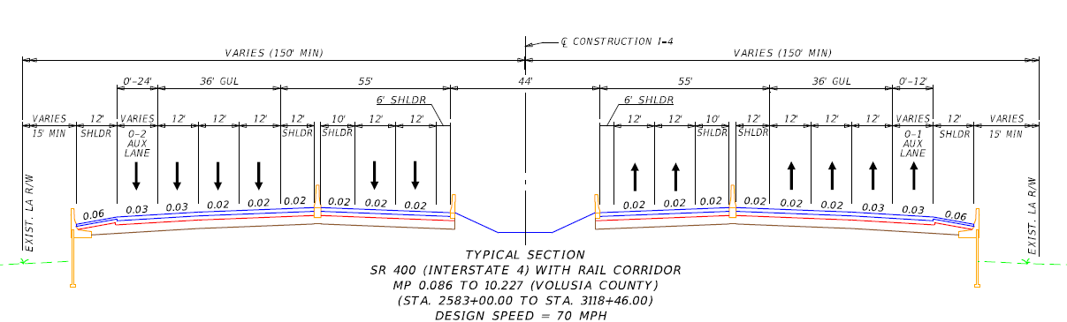
I-4 Managed Lanes
Mainline I-4 Typical Section
Two Alternatives Developed
      Alt 1 – Without rail corridor
      Alt 2 – With transit corridor (PREFERRED ALTERNATIVE)

Slide 22
I-4 Managed Lanes
Express Lane Limits
Carry two lanes each direction to east of Dirksen and one lane each direction to past Rhode Island
Carry two lanes each direction all the way to Rhode Island
(PREFERRED ALTERNATIVE)

Slide 23
I-4 Managed Lanes
DECISIONS
Option | Express Lanes |  | Rail | Homes Impacted |  | Businesses Impacted |  | Ponds (Acres) | Wetland Impacts (Acres) | Costs (Millions of Dollars)
 | County Line to Dirksen Drive | Dirksen Drive to Rhode Island
 |  |  |  | Partial | Full | Partial | Full |  |  | Wetlands Mitigation | Right of Way | Construc tion | Total
1 | 2 | 2 | NO | 0 | 0 | 1 | 0 | 9.6 | 3.8 | 0.4 | 0.4 | 290 | 290.8
2 | 2 | 2 | YES | 2 | 24 | 3 | 1 | 13.5 | 13 | 1.5 | 10.1 | 308 | 319.6
3 | 2 | 1 | NO | 0 | 0 | 0 | 0 | 5.4 | 3.8 | 0.4 | 0.4 | 286 | 286.8
4 | 2 | 1 | YES | 0 | 24 | 0 | 0 | 9.3 | 13 | 1.5 | 10.1 | 294 | 305.6

Slide 24
District Five
Projects Update
November, 2014
Florida Department of TRANSPORTATION

